Slide 1
Introduction to Data science
BCA – VI M+AN(Elective)
Course Leader - Ms. Rajni Dubey

Slide 2
Introduction to Data Science
Data Science deals with extracting useful information from data.
It helps in analysis, prediction, and decision making.
Example: Analyzing student marks to improve academic performance
data science can help answer following question:
What do customer want?
How can we improve our services?
What will the upcoming trend in sales?
How much stock they need for upcoming festival.

Slide 3
Data Science Skills
All these data science actions are performed by a Data Scientists.
Programming Languages: Python, R, SQL.
Mathematics: Linear Algebra, Statistics, Probability.
Machine Learning: Supervised and unsupervised learning, deep learning basics.
Data Manipulation: Pandas, NumPy, data wrangling techniques.
Data Visualization: Matplotlib, Tableau, Power BI.
Big Data Tools: Hadoop, Spark, Hive.
Databases: SQL, NoSQL, data querying and management.
Cloud Computing: AWS, Azure, Google Cloud.
Domain Knowledge: Industry-specific expertise for problem-solving.
Soft Skills: Communication, teamwork, and critical thinking.

Slide 4
Objectives of Data Science
Understand the basic concepts of Data Science
To learn how data is collected, cleaned, and analyzed.
Understand the data science life cycle
To Build foundation for AI and ML
To improve analytical and decision-making skills.

Slide 5
Why We Study Data Science
Data is generated everywhere
Convert raw data into information
Improve analytical skills
Used by companies for planning
Career-oriented subject

Slide 6
Importance of Data Science
Helps in data-driven decisions
Saves time and cost
Improves efficiency
Supports research and innovation

Slide 7
Future Scope of Data Science
High demand career
Used in all industries
Growth in AI and ML
Global job opportunities
Long-term career growth

Slide 8
Career Opportunities in Data Science
These are some major career options in data science field:
Data Scientist: Analyze and interpret complex data to drive business decisions.
Data Analyst: Focus on analyzing and visualizing data to identify patterns and insights.
Machine Learning Engineer: Develop and deploy machine learning models for automation and predictions.
Data Engineer: Build and maintain data pipelines, ensuring data is clean and accessible.
Business Intelligence (BI) Analyst: Create dashboards and reports to support strategic decisions.
AI Research Scientist: Conduct research to develop advanced AI algorithms and solutions.
Big Data Specialist: Handle and analyze massive datasets using tools like Hadoop and Spark.
Product Analyst: Evaluate product performance and customer behavior using data.
Quantitative Analyst: Analyze financial data to assess risks and forecast trends.

Slide 9
Where data science is being used?
Data Science is being used in almost all major industry. Here are some examples:
Predicting customer preferences for personalized recommendations.
Detecting fraud in financial transactions.
Forecasting sales and market trends.
Enhancing healthcare with predictive diagnostics and personalized treatments.
Identifying risks and opportunities in investments.
Optimizing supply chains and inventory management.

Slide 10
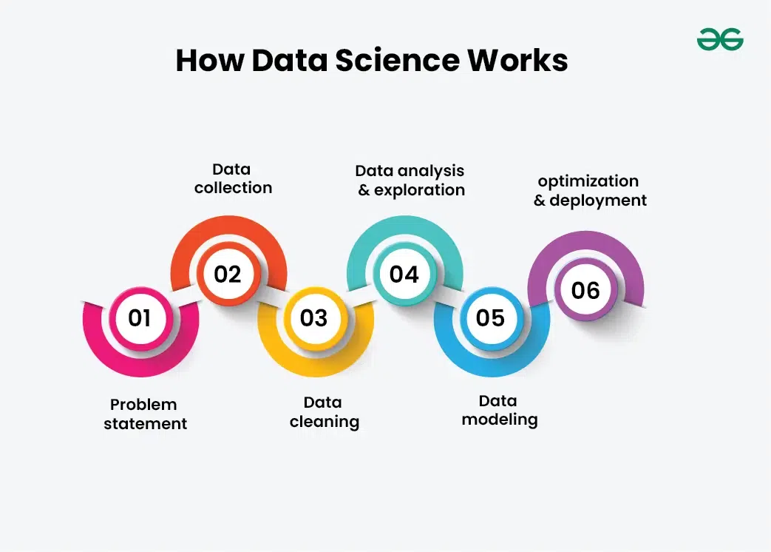
Data Science Life Cycle
Data science is not a one-step process, It's passes from many stages and every element is important. One should always follow the proper steps to reach the ladder. Every step has its value and it counts in your model.

Slide 11
1. Problem Statement: It's really important to declare or formulate your problem statement very clearly and precisely. Your whole model and it's working depend on your statement. So make sure what's your problem statement and how well can it add value to business or any other organization.
2. Data Collection: After defining the problem statement, find all that you need. Data can be in any form i.e unstructured or structured. It might be in various forms like videos, spreadsheets, coded forms, etc. You must collect all these kinds of sources.
3. Data Cleaning: Data cleaning is all about the removal of missing, redundant, unnecessary and duplicate data from your collection. There are various tools to do so with the help of programming in either R or Python.

Slide 12
4. Data Analysis and Exploration: It's about analyzing the structure of data, finding hidden patterns in them, studying behaviors, visualizing the effects of one variable over others and then concluding. In R, GGplot is one of the most famous models while Matplotlib in Python.
5. Data Modelling: Here, you must choose a good algorithm that best fit to your model. There different kinds of algorithms from regression to classification, SVM( Support vector machines), Clustering, etc. Your model can be of a Machine Learning algorithm. You train your model with the train data and then test it with test data.

Slide 13
6. Optimization and Deployment: Check the efficiency of the data model and thus try to optimize it for better accurate prediction. Deployment deals with the launch of your model and let the people outside there to benefit from that. You can also obtain feedback from organizations and people to know their need and then to work more on your model.

Slide 14
Association rule
Association Rule Mining finds frequent patterns (items/events occurring together) in large datasets, revealing "if-then" relationships, like "if bread, then butter" in market baskets, using metrics like Support (how often items appear) and Confidence (rule strength) to generate actionable rules for cross-selling, recommendations, and insights.
The process first finds frequent itemsets, then builds association rules (X -> Y) from them, essential for understanding customer behavior and data correlations.

Slide 15
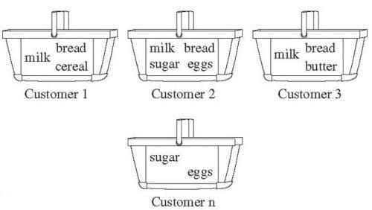
Frequent Pattern Mining

Slide 16
Key Concepts
Frequent Patterns: Itemsets, subsequences, or substructures that appear often in a dataset (e.g., milk & bread).
Association Rules: "If-Then" statements (e.g., {Diapers} -> {Beer}) showing item relationships, crucial for data mining.
Market Basket Analysis: A classic application finding items bought together (e.g., in shopping carts).

Slide 17
Core Metrics
Support: Measures how often an itemset appears in all transactions (Frequency).
Confidence: Measures the likelihood of the consequent (Y) appearing, given the antecedent (X) (Rule Strength).

Slide 18
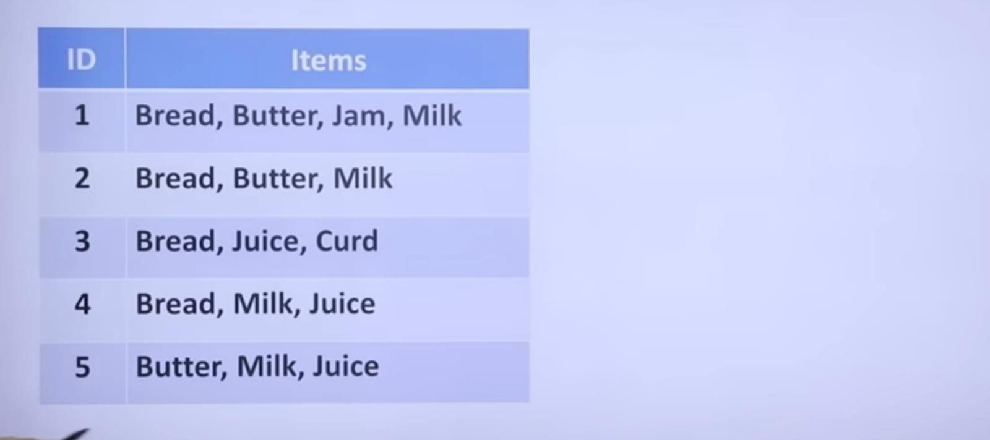

Slide 19
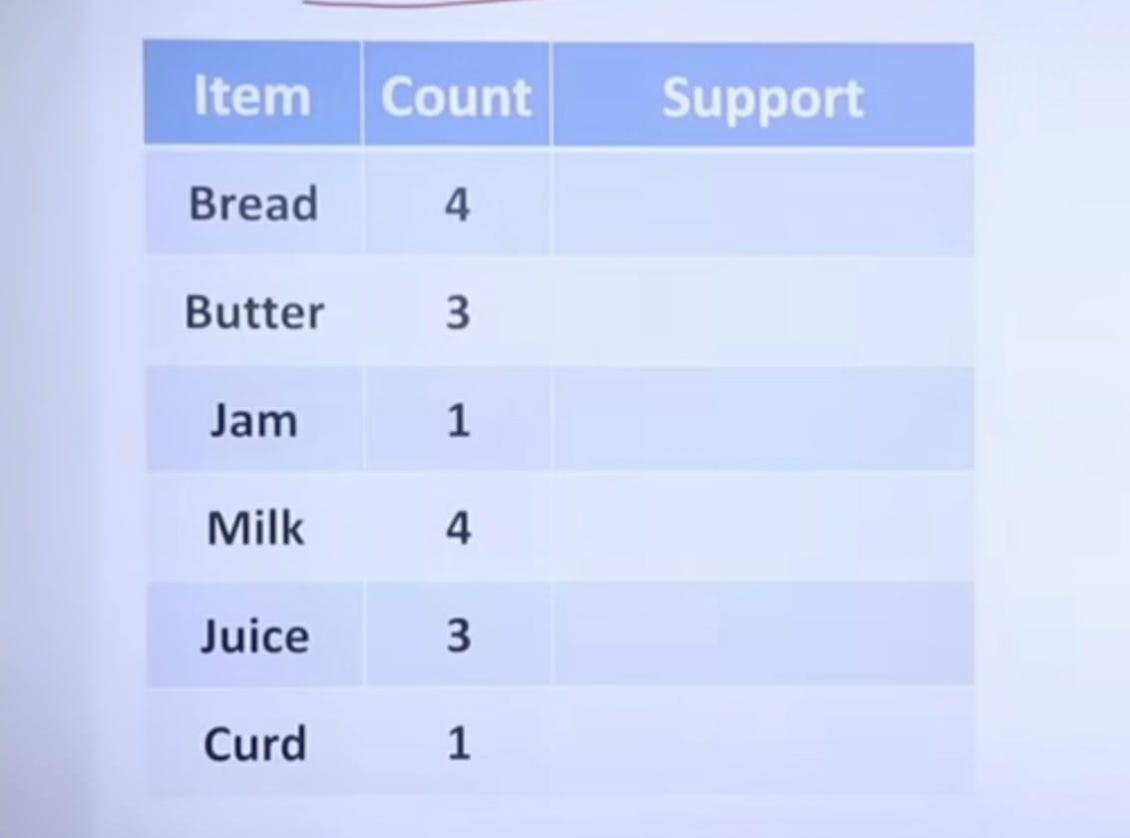

Slide 20
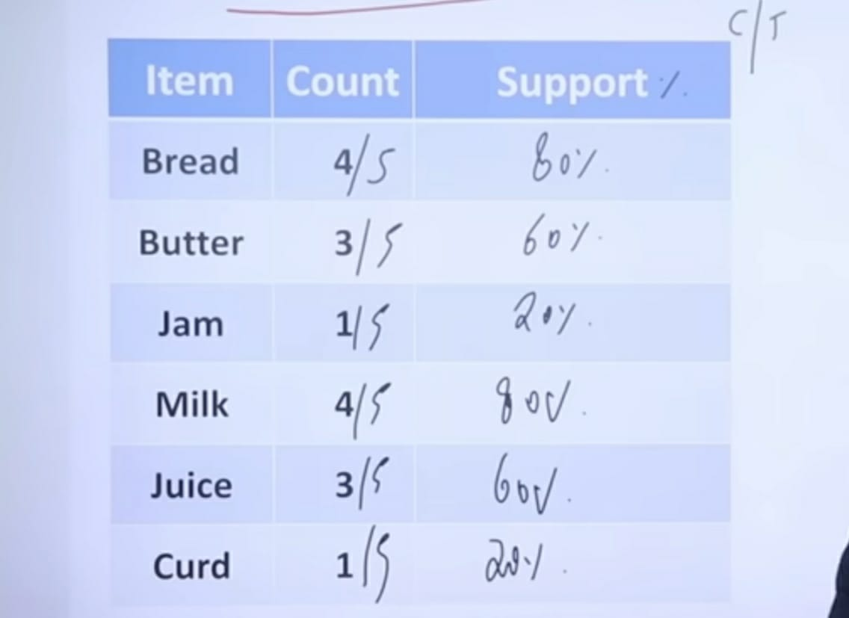

Slide 21
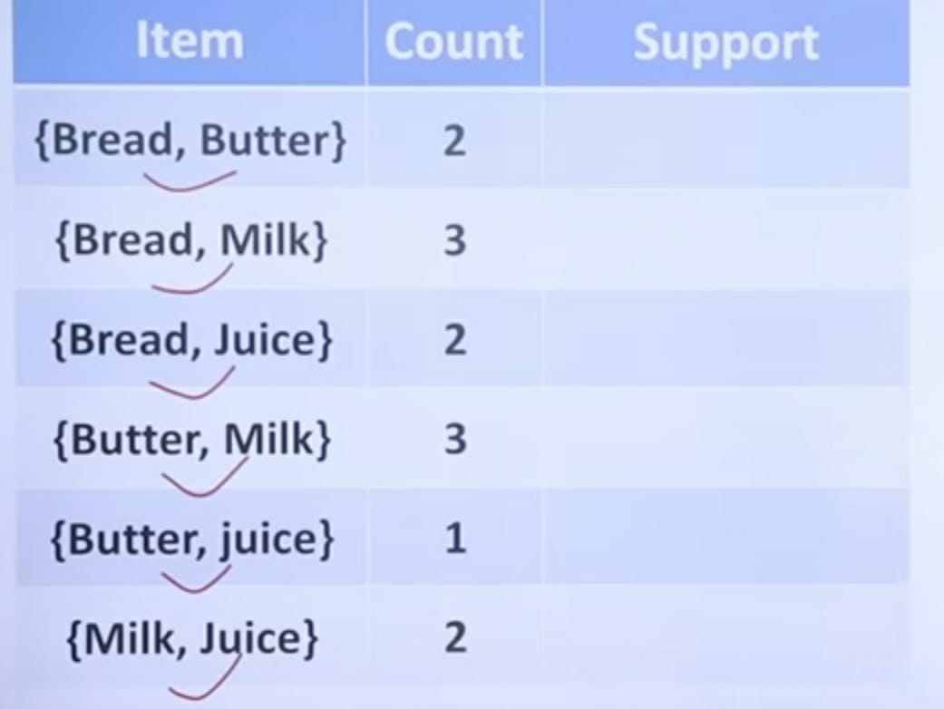

Slide 22
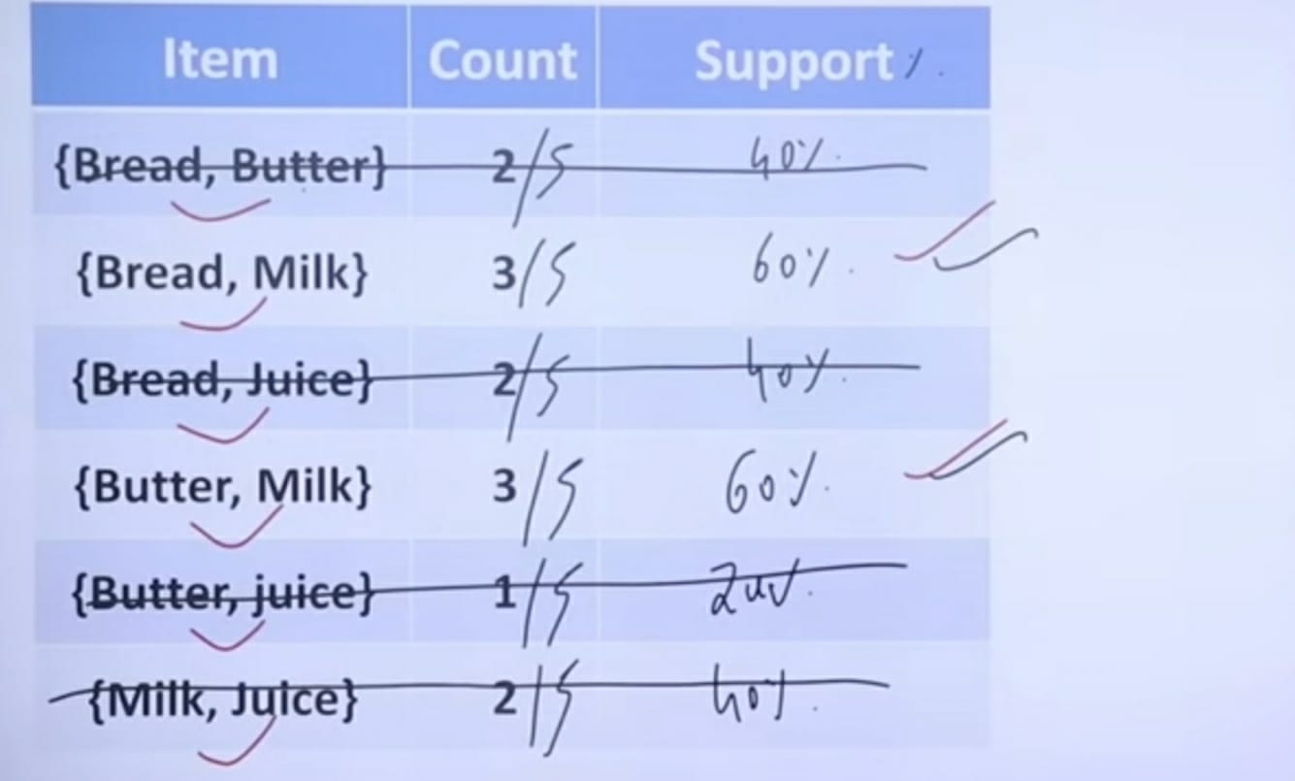

Slide 23
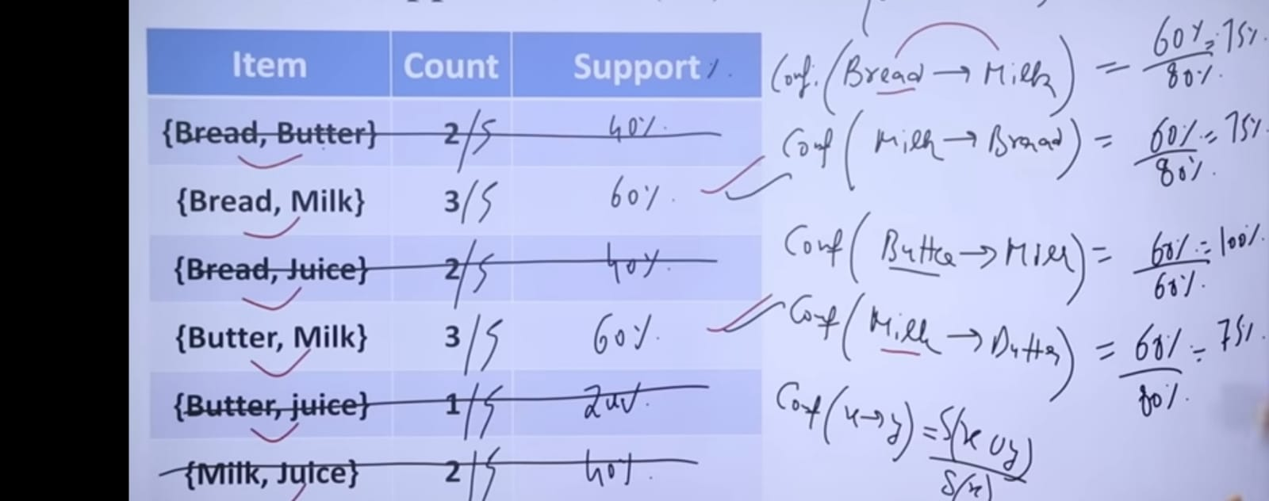

Slide 24
